Slide 1

Introduction to Support Vector Machines
Presented by:
Elizer Ponio Jr.
Department of Computer Science
College of Computing and Information Technologies

Slide 2
Outline
Introduction
SVM Terminologies
Types of SVM

Slide 3
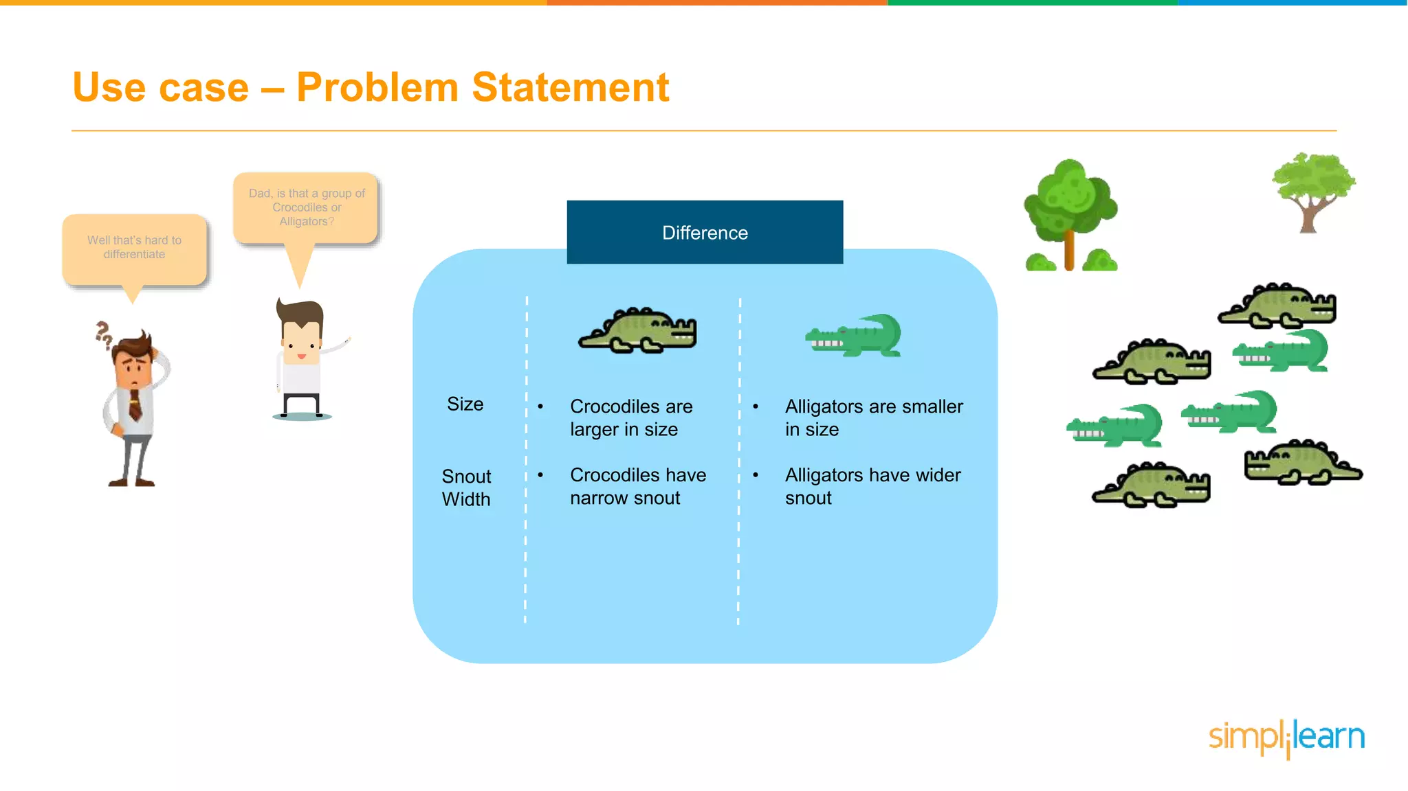
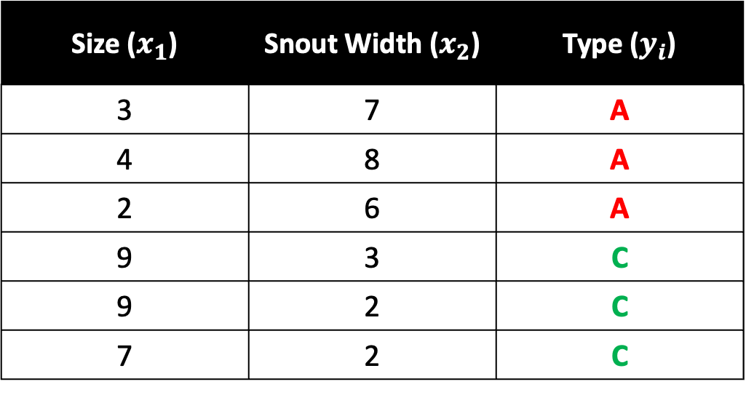
Crocodile and Alligator Example
Size ($x_{1}$) | Snout Width ($x_{2}$) | Type ($y_{i}$)
3 | 7 | A
4 | 8 | A
2 | 6 | A
9 | 3 | C
9 | 2 | C
7 | 2 | C

Slide 4
Snout Width
Size

Slide 5
Which line do we choose to separate the two classes of data?
Line 1
Line 2
Snout Width
Line 3
Size

Slide 6
Line 1 is too close to
If there is a new data point near
Line 1
and is below Line 1, then we will classify it as a crocodile which is wrong
Snout Width
Size

Slide 7
Line 3 is too close to
If there is a new data point near
and is above Line 3, then we will classify it as an alligator which is wrong
Snout Width
Line 3
Size

Slide 8
Line 2 is just right
Line 2 is somewhere in the middle between the two classes in our dataset, alligator and crocodile
Snout Width
Line 2
If there is a new data point near and
Then they would be correctly classified!
Size

Slide 9
Believe it or not, that is the end of SVM, thats how SVM works
SVM chooses the best line who gives the most distance between the two classes that we are trying to classify
Snout Width
Line 2
Size

Slide 10
Outline
Introduction
SVM Terminologies
Types of SVM

Slide 11

In SVM, the line that we have drawn is called the decision boundary
Snout Width
Size

Slide 12
Ideally, the decision boundary should be in the middle and as far away from both classes as possible so that we maximize something called the margin of separation or margin
Snout Width
Size

Slide 13
The margin is a space where the distance of the alligator class from the decision boundary should be the same/equal as the crocodile class
Snout Width
Size

Slide 14


The name “Support Vector” comes from the data points or observations in our training data get the special name of Support Vectors.
Snout Width
Support Vector
Support Vector
Size

Slide 15


What makes these Support Vectors special is that these data points are lying closest to the decision boundary. These data points play a vital role in defining the decision boundary and the margin of separation.
Snout Width
Support Vector
Support Vector
Size

Slide 16
Outline
Introduction
SVM Terminologies
Types of SVM

Slide 17
There are two types of SVM, hard margin SVM and soft margin SVM
Snout Width
Size

Slide 18
Hard margin SVM or Linear SVM is our “normal SVM” we have been talking about from the introduction where one side of the decision boundary gets classified as +1 and everything on the other side gets classified as -1
Snout Width
Size

Slide 19
Hard margin SVM is good for data sets that are linearly separable where you we can simply draw a decision boundary which achieves this separation
Snout Width
Size

Slide 20
One of the disadvantages of Hard Margin SVM are outliers.
If outliers are not removed/ignored, they can become a support vector which will result into an incorrect decision boundary.
Snout Width
Size

Slide 21

And unfortunately, most datasets in the real-world are not linearly separable
Snout Width
Size

Slide 22
Consider this real-world dataset that contains a few data points that make it so that you cannot draw a straight line.
Snout Width
Size

Slide 23
Hard margin SVM cannot deal with this dataset because it needs a clean separated of two classes.
Snout Width
Size

Slide 24
To deal with this problem, we will use a Soft Margin SVM
Snout Width
Size

Slide 25
Soft Margin SVM or Non-Linear SVM is similar to Hard Margin SVM where it draws a decision boundary to separate two classes except…
Snout Width
Size

Slide 26
We will allow some mistakes but we will give a penalty for every mistake our model will make and a even bigger penalty if the mistake is bigger
Snout Width
Size

Slide 27
References
https://www.ibm.com/topics/support-vector-machine#:~:text=What%20are%20SVMs%3F,in%20an%20N%2Ddimensional%20space.
https://www.youtube.com/watch?v=iEQ0e-WLgkQ&t=107s

